Slide 1

Machine Learning in Game
P Sivakishore
20-May-2020

Slide 2
Who Am I ?
I‘m a Bluetooth verification Programmer for Client Intel.
Ex-Game Developer (Real Cricket)
Console Gameplayer

Slide 3
Agenda
Develop an Bot to play Tetris
Tetris Introduction
Game Algorithm (Min Max)
Solve Tic Tac Toe using MinMax
Try to use MinMax to develop Bot for Tetris
Introduction to Neural Network
How to Use Neural Network
Try to Use Convolutional neural network (CNN)
What is Convolutional Neural Network(CNN)
Develop Tetris Bot using CNN
Demo

Slide 4
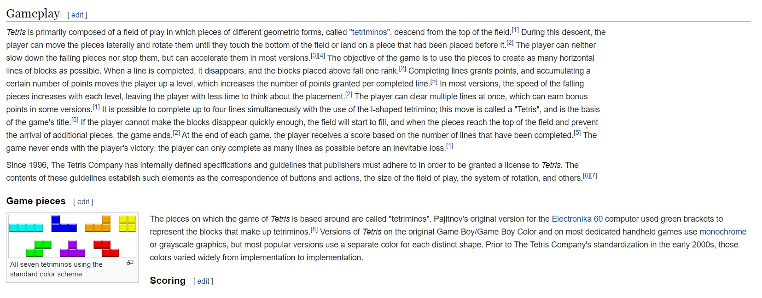
Tetris Introduction
Wikipedia

Slide 5
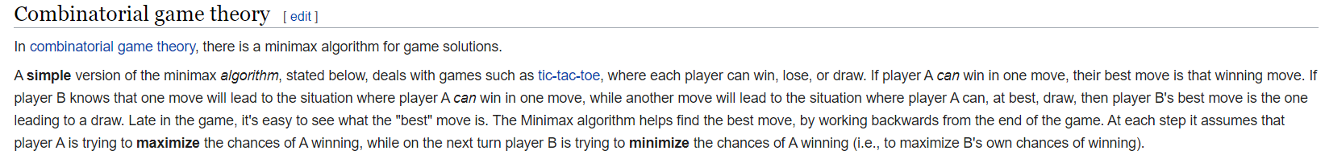
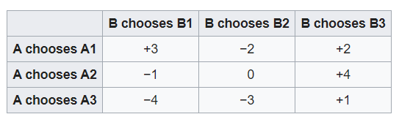
Game Algorithm (MinMax)
5

Slide 6
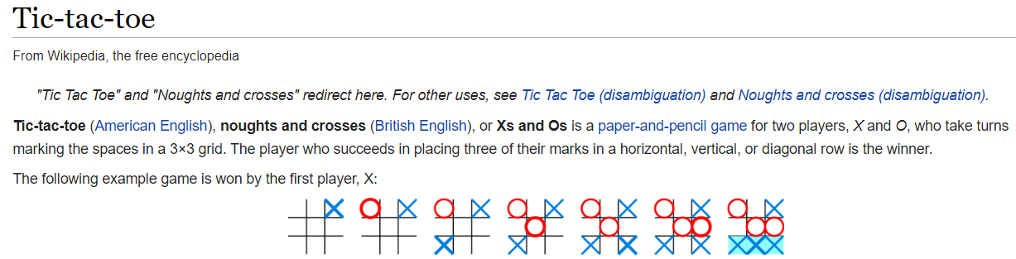
Solve Tic Tac Toe using MinMax

Slide 7
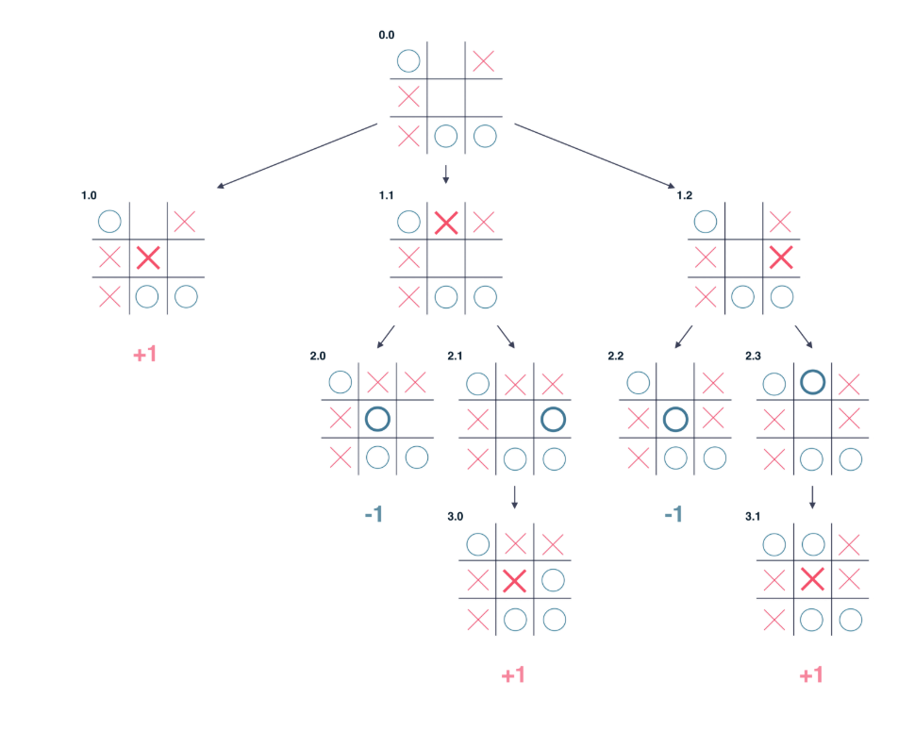
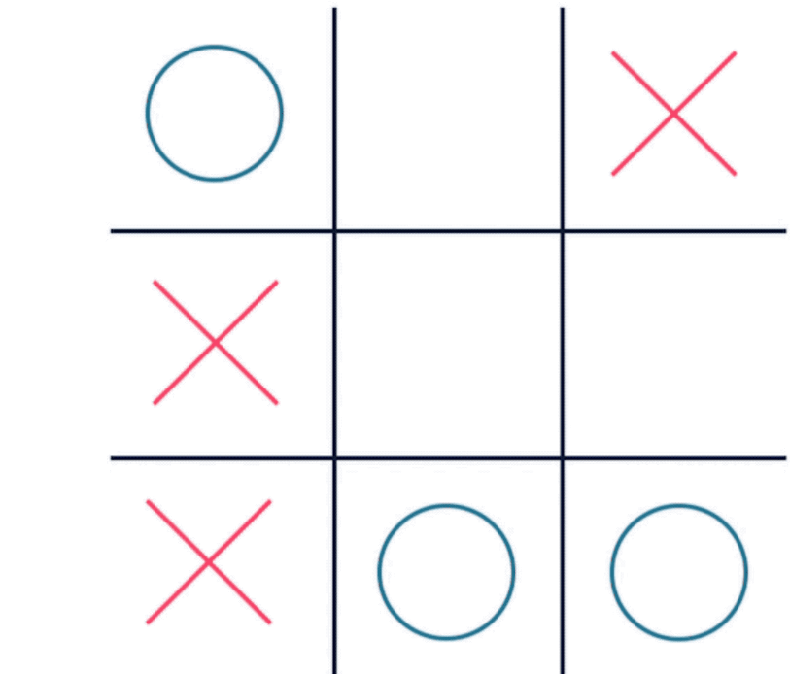
Solve Tic Tac Toe using MinMax cont..
Consider Below Tic Tac Toe State

Slide 8
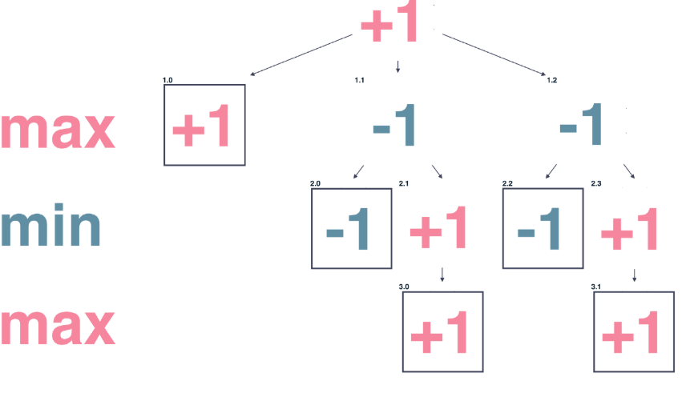
Solve Tic Tac Toe using MinMax cont..
In a tree structure

Slide 9
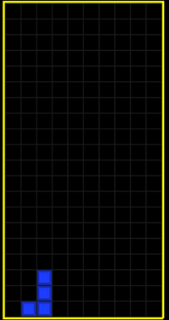
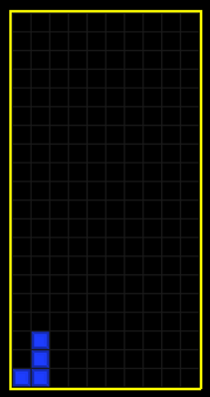
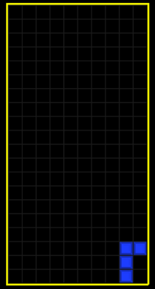
Try to use MinMax to develop a Bot for Tetris
Get All Possible state of random piece that can be placed on Board
Write a Min and Max evaluation function to decide Min and Max for given Possible state of random piece
Difficult function to write and completely violates the purpose of the project

Slide 10
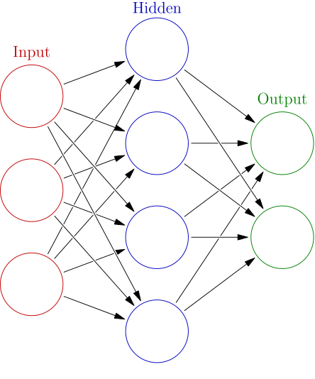
Introduction to Neural Network
Perceptron is a single layer neural network and a multi-layer perceptron is called Neural Networks.
The perceptron consists of 4 parts.
Input values or One input layer
Weights
Net sum
Activation Function
10

Slide 11
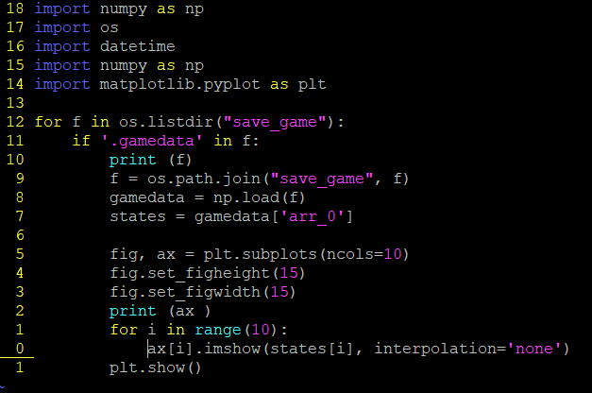
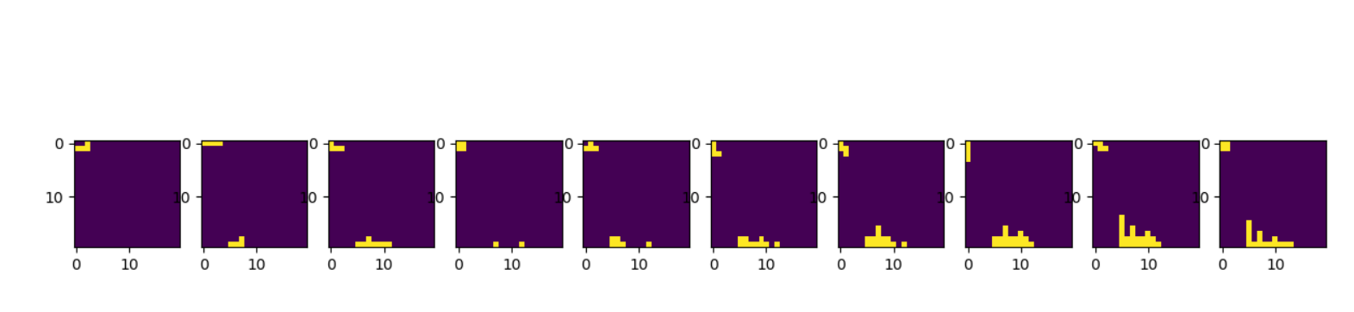
How to use Neural Network

Slide 12
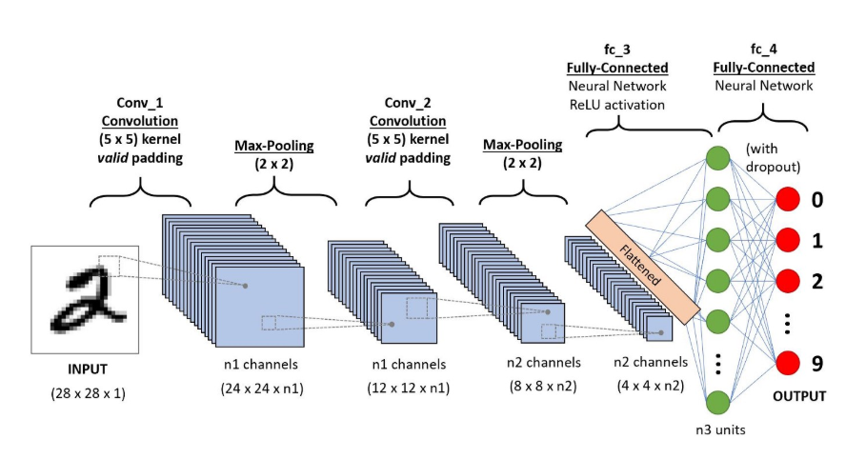
Try to Use Convolutional neural network

Slide 13
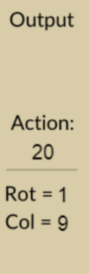
Try to Use Convolutional neural network
Input
output
rotation = (output / 10) = {0, 1, 2, 3} column = (output % 10) = {0, 1, 2, 3, 4, 5, 6, 7, 8, 9}

Slide 14
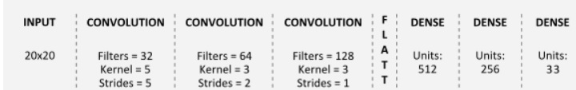

Develop Tetris Bot using CNN
Optimizer: Adam with a learning rate of 0.003
Loss Function: Categorical Cross Entropy
Evaluation Metric: Accuracy
Train Data
No Proper game data online
Self played game of 100 lines * 10000
Using TensorFlow to build CNN

Slide 15
Demo

Slide 16
References
https://en.wikipedia.org/wiki/Tic-tac-toe
https://www.geeksforgeeks.org/minimax-algorithm-in-game-theory-set-1-introduction/
https://en.wikipedia.org/wiki/Tetris
http://news.mit.edu/2017/explained-neural-networks-deep-learning-0414
https://towardsdatascience.com/a-comprehensive-guide-to-convolutional-neural-networks-the-eli5-way-3bd2b1164a53
https://www.tensorflow.org/
https://pytorch.org/
https://www.youtube.com/watch?v=gZmobeGL0Yg&list=PLZbbT5o_s2xq7LwI2y8_QtvuXZedL6tQU
16

